Slide 1
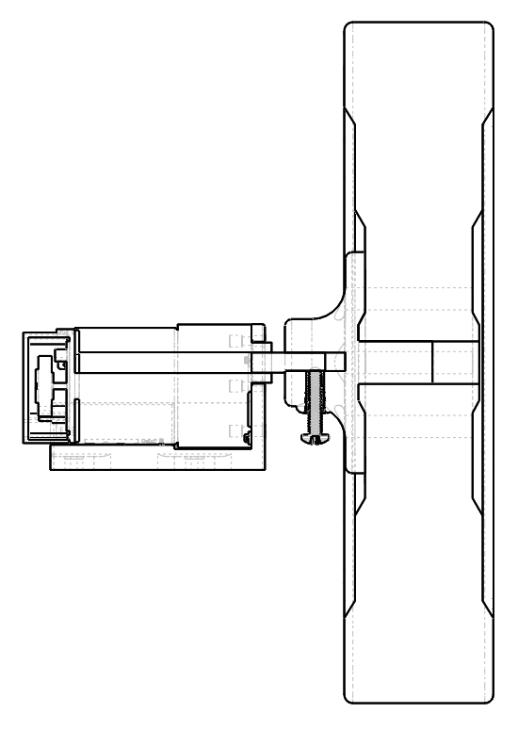
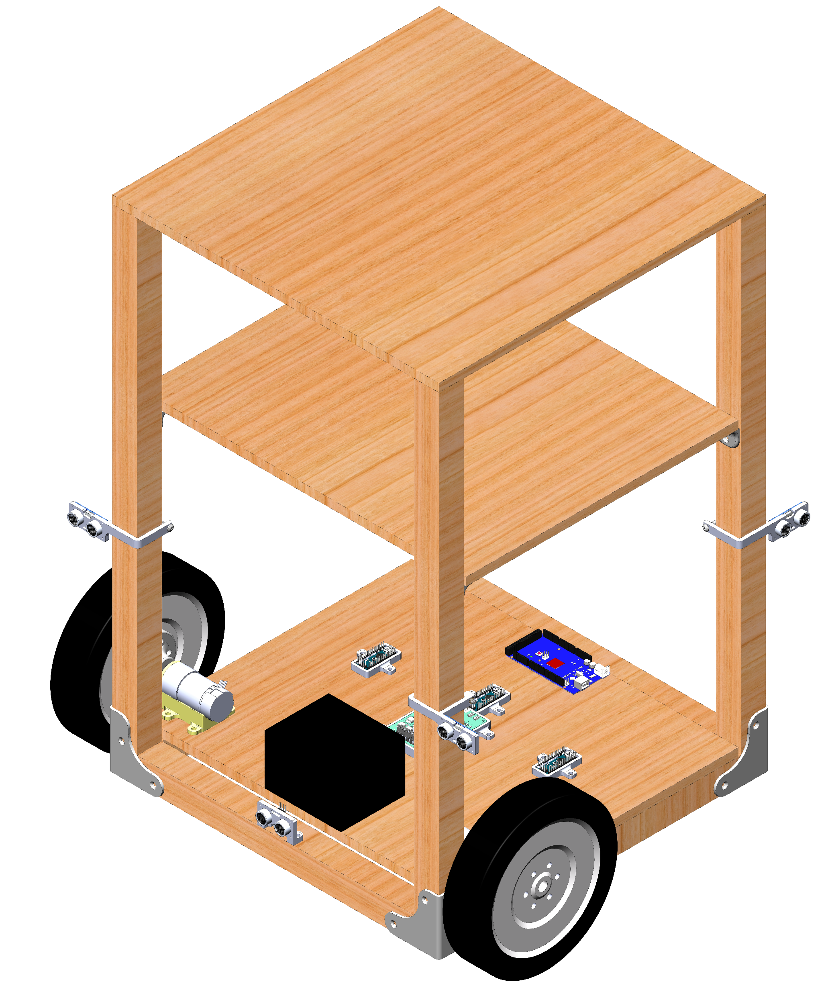
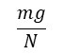
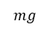
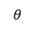
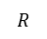
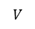
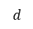
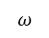
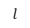
$$R$$
$$ω$$
$$d$$
$$V$$
$$θ$$
$$mg$$
$$l$$
Basket platform
$$\frac{mg}{N}$$
Lower shelf
Shelf support
SLA
Battery
Mounted
motor
Controllers and
drive platform
Corner brace
Wheel
Mounted
ultrasonic sensor

Slide 2
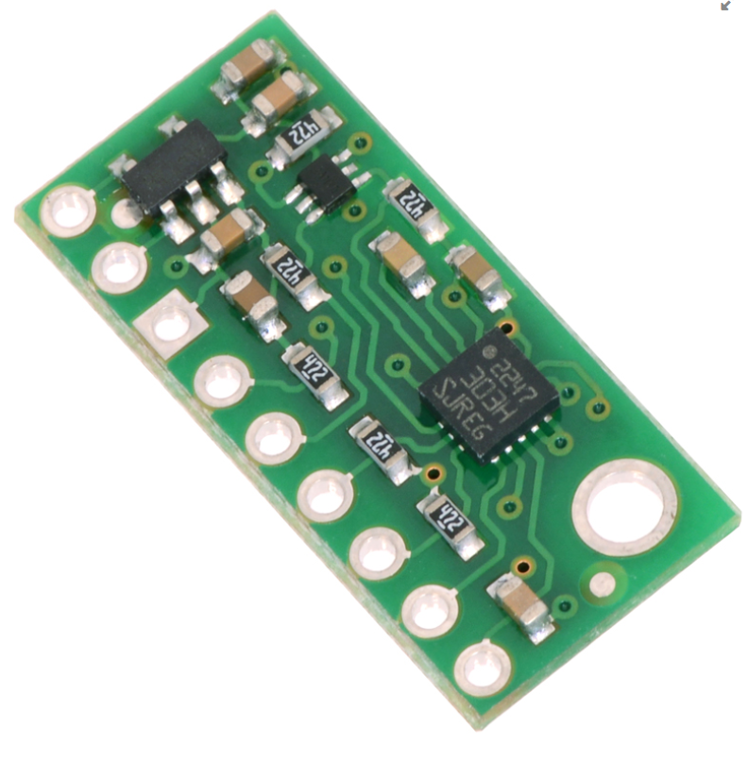
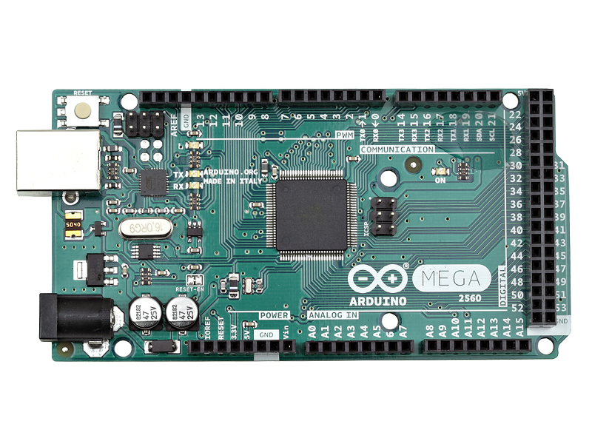
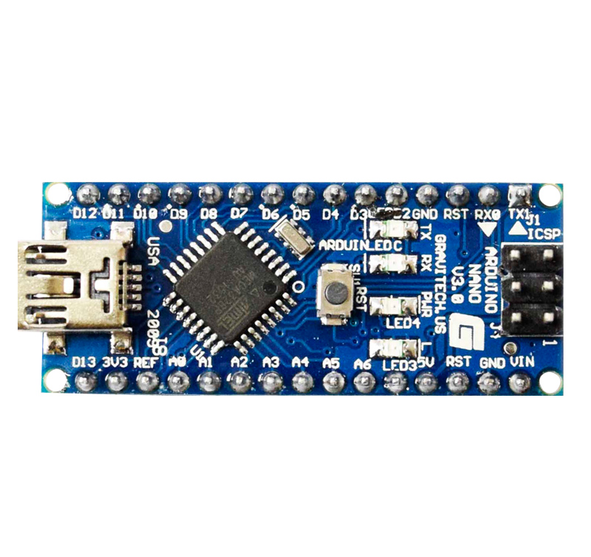
Compass IC (slave)
Absolute
heading
Left wheel
velocity
Right wheel
velocity
Left PWM
signal
Right PWM
signal
Arduino Nano (slave)
Arduino Nano (slave)
Arduino Mega (master)
Obstacle
direction
Arduino Nano (slave)

